Slide 1
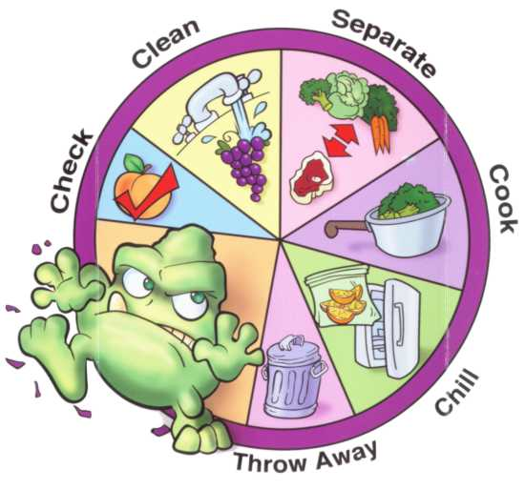
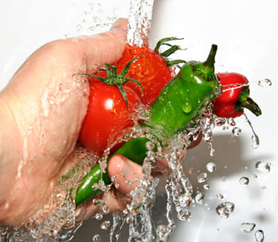
Metabolic Diseases Lesson 1.3
How clean is your food?

Slide 2
Do Now
The food we eat has been handled by numerous people, how safe is it? At what points can safety be compromised?

Slide 3
Food safety
The food we eat has been handled by numerous people, how safe is it? At what points can safety be compromised?
What types of microbe commonly contaminate foods?
Are there any other ways food safety could be compromised?

Slide 4
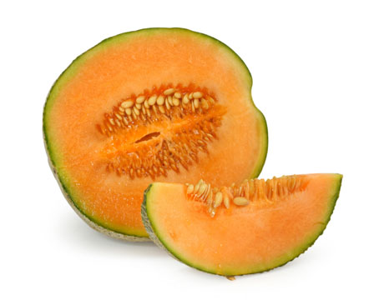
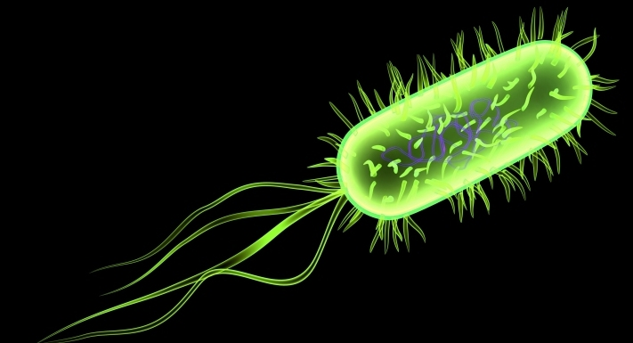
Activity Food Safety Case Studies
Break into four groups and compete the case study worksheets.
In 20 minutes one member of your group will give a three minute brief to the class on your case.

Slide 5
Details | Case 1 | Case 2 | Case 3 | Case 4
When did it happen?
What food was affected?
How many people got sick?
What were the signs or symptoms?
What microbe or toxin caused it?
What was done?
How could it have been avoided?

Slide 6
Wrap Up
We have been focusing on contamination of food in the context of food production.
Are we passive victims of the industrial food machine? Or are there practices we as consumers can use to prevent foodborne illness? How effective are those strategies likely to be?

Slide 7
Preventing food-borne illness
Food | Contaminant | Technique
Meat
Fatty fish
Eggs
Dairy
Leafy vegetables
Sprouts
Thin skinned fruit
Thick skinned fruit
Fruit juices

Slide 8
Preventing food-borne illness
Food | Contaminant | Technique
Meat | Salmonella, E. Coli, Antibiotics
Fatty fish | Mercury
Eggs | Salmonella
Dairy | Listeria, antibiotics
Leafy vegetables | Salmonella, E. Coli, pesticides
Sprouts | E. Coli
Thin skinned fruit | Pesticides
Thick skinned fruit | Listeria
Fruit juices | Pesticides

Slide 9
Preventing food-borne illness
Food | Contaminant | Technique
Meat | Salmonella, E. Coli, Antibiotics | Smell & color; dispose of wrappings; cook thoroughly; store safely; dispose of in a timely way; limit exposure
Fatty fish | Mercury | Limit intake
Eggs | Salmonella | Store at proper temperature; cook properly; do not use after sell-by date.
Dairy | Listeria, antibiotics | Store at proper temperature; do not use after sell-by date; limit intake.
Leafy vegetables | Salmonella, E. Coli, pesticides | Wash properly*
Sprouts | Salmonella, E. Coli | Wash properly*
Thin skinned fruit & vegetables | Pesticides | Wash properly, cook
Thick skinned fruit & vegetables | Listeria | Wash then remove skin
Fruit juices | Pesticides | Limit intake of processed juices

Slide 10
What does your kitchen look like?
Food | Contaminant
Hands | Wash hands for at least 45 seconds, especially after handling raw meat
Storage | Make sure refrigerator is at 40°F and freezer is at 0°F or less . Clean up spills immediately.
Countertops | Clean spills immediately. Disinfect regularly.
Cutting boards | Avoid cross-contamination by using separate boards for meat and vegetables.
Sponges | Microwave for 1 minute once a week or put in dishwasher. Don’t use for more than a month.
Dishrags | Wash regularly at high temperature
Utensils | Wash after touching raw meat and use separate utensils for meat and vegetables.

Slide 11
Homework
Over the rest of Unit 1 we will begin to focus on what’s in food that’s actually nutritious - the nutritional components of foods.
Tonight, set up an account in MyPlate:
http://www.choosemyplate.gov/supertracker-tools/supertracker.html
Use the worksheet to track what you ate at your last three meals
Identify the major components (protein, fats, carbs, vitamins, fiber and water) that were in each of those meals

